Slide 1


Telangana Growth Analysis
SAI PRANEETH ADIGOPULA

Slide 2



Table of Contents:
Explore Stamp Registration, Transportation and Ts-Ipass Datasets.
Understand their attributes, categories and time period.
Analyze trends and patterns within each department.
Identify growth opportunities and areas needing attention.
Find correlation among these departments and report the overall growth of the
state through insights and relevant visuals such as shape maps.

Slide 3

A bout Telangana
Telangana, India's youngest state formed on June 2, 2014, is known as the "Seed Hub" due to its significant seed exports to Asia and Africa.
Hyderabad, the bustling capital, combines historical landmarks with a thriving high-tech industry, earning it the title of "Pharma Capital of India" for its pharmaceutical and biotechnology sector.
The state's diverse topography, characterized by rolling hills, plateaus, and fertile plains, fosters economic growth, particularly in agriculture and related activities.
Telangana's economy is also boosted by a rapidly growing aerospace and defense sector, infrastructure development, and the presence of defense research organizations and manufacturing units.
The state's rich cultural heritage, historical sites, and untapped tourism potential offer opportunities for job creation and economic growth through tourism promotion.

Slide 4

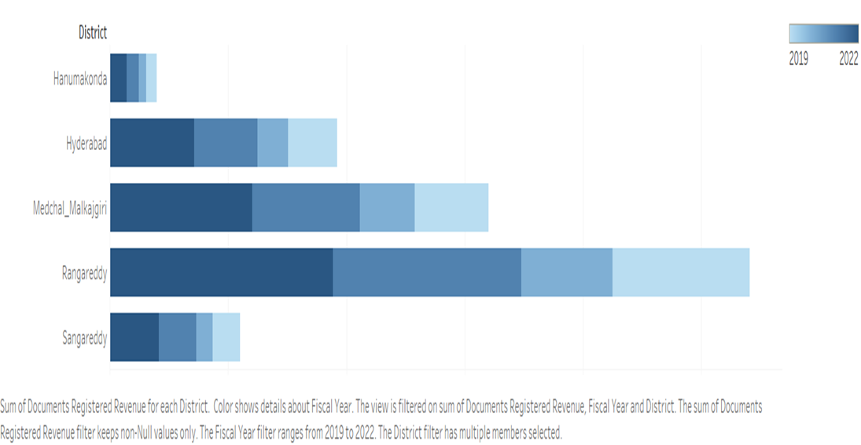
Question-1
How does the revenue generated from document registration vary across districts in Telangana?
List down the top 5 districts that showed the highest document registration revenue growth between FY 2019 and 2022.
It shows there is lot of economic activity happening in the state. And people from this districts showing interest to invest the in the property and other assets.
One needs to register the legal documents so as to prevent any property dispute, fraud, conserve the evidence, be assured of the title and publicizing the information.
Ranga Reddy seems to have the most documents registered for the FY 2019 to 2022, followed by Medchal and Hyderabad.
Note: Just pause and take a brief look

Slide 5

Insights -
Revenue generated from document registration can fluctuate between Telangana districts due to several influencing factors. These factors include:
Population and Urbanization: Districts that are more densely populated and urbanized tend to witness a higher volume of real estate transactions. Consequently, they generate more revenue from document registration. Urban areas typically experience increased property transactions and higher property values.
Property Values: Districts with elevated property values generally contribute more revenue through document registration. Urban districts, or those with a thriving real estate market, often feature higher property values, leading to increased registration income.
Economic Activity: Districts boasting a robust economy, numerous businesses, and industrial activities usually record higher levels of property transactions. This heightened economic activity directly contributes to increased registration revenue.
Several other factors can also contribute to variations in document registration revenue, such as government policies, geographic location, and legal and regulatory factors.

Slide 6
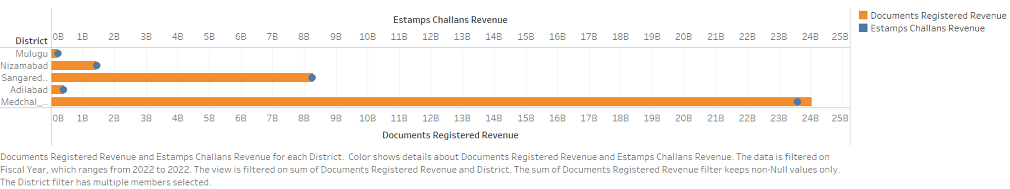
Question-2
How does the revenue generated from document registration compare to the revenue generated from e-stamp Callahan across districts? List down the top 5 districts where e-stamps revenue contributes significantly more to the revenue than the documents in FY 2022?
Here are the top 5 districts that generated revenue from e-stamps comparatively higher than document registration in FY 2022.
Some districts may have a higher adoption of digital methods for document registration, leading to more e-stamps challans being used compared to traditional paper documents.
E-stamps are often seen as more convenient
and efficient compared to traditional paper documents.

Slide 7
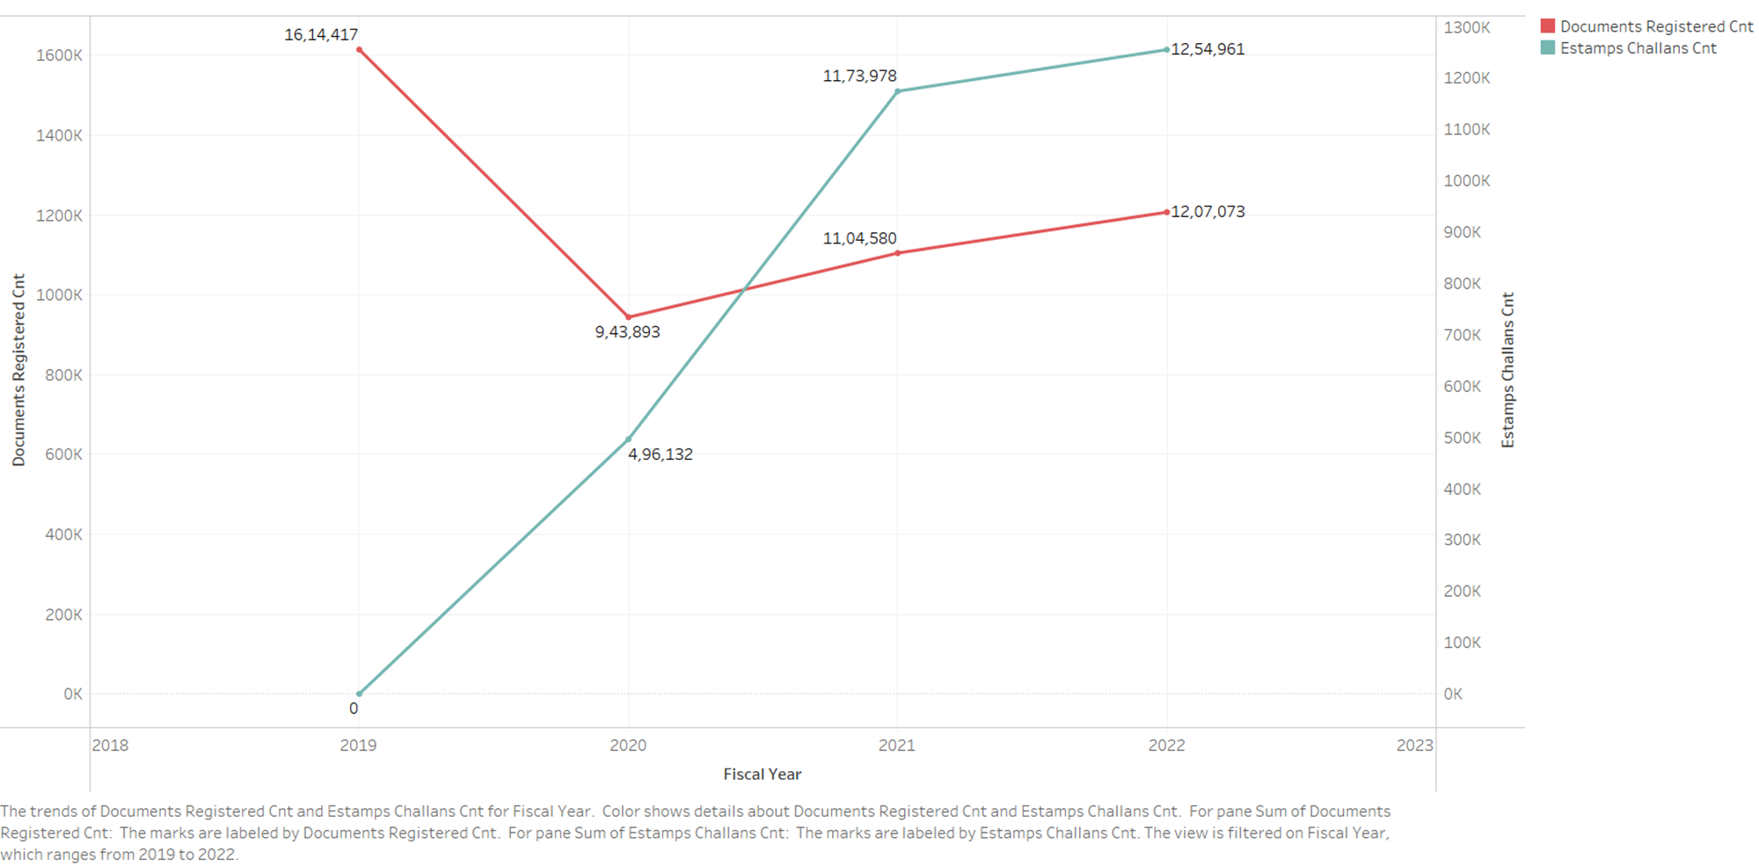
Question-3
Is there any alteration of e-Stamp challan count and document registration count pattern since the implementation of e-Stamp challan? If so, what suggestions would you propose to the government?
Yes, there has been significant alteration of e- stamps challan count. But document registrations count has been reduced from 2019- 2022.
As per data, e-stamps challan was established in Telangana at year 2021 (may be due to covid).

Slide 8
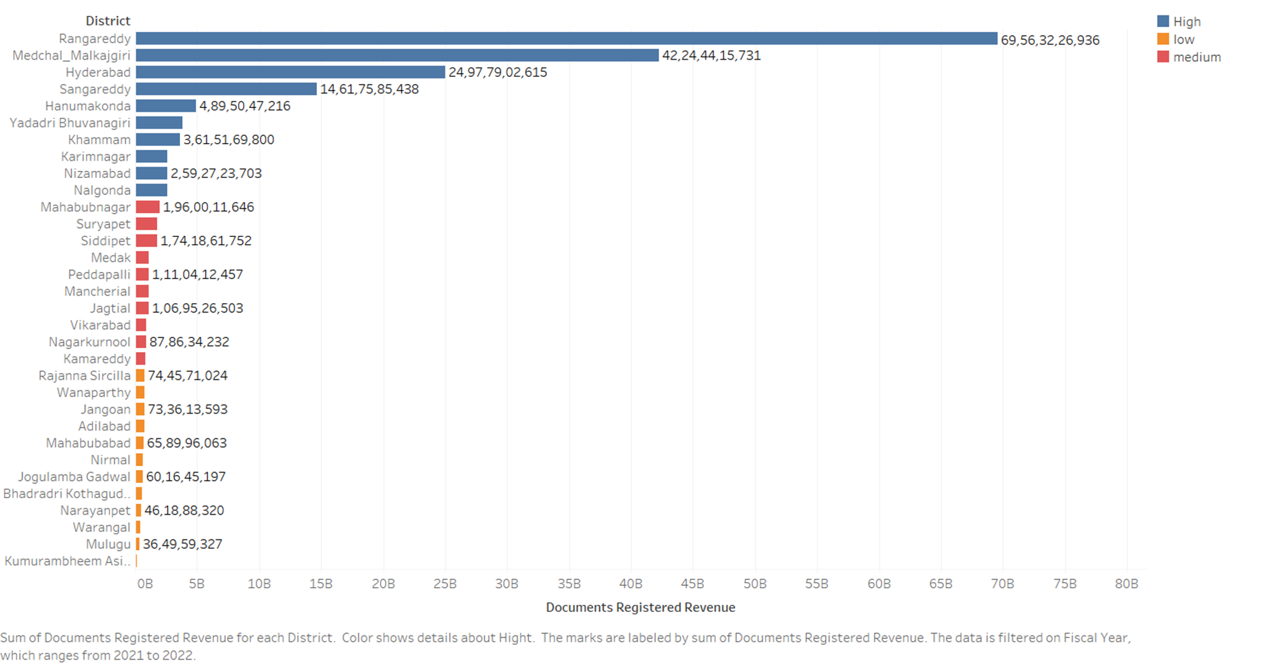

Question-4
Categorize districts into three segments based on their stamp registration revenue generation during the fiscal year 2021 to 2022.
In the year 2021-2022, districts have been categorized into three segments based on their registration revenue preferences. These segments are visually represented in a bar plot through distinct colors, allowing for a quick glance at the distribution of districts across the segments

Slide 9
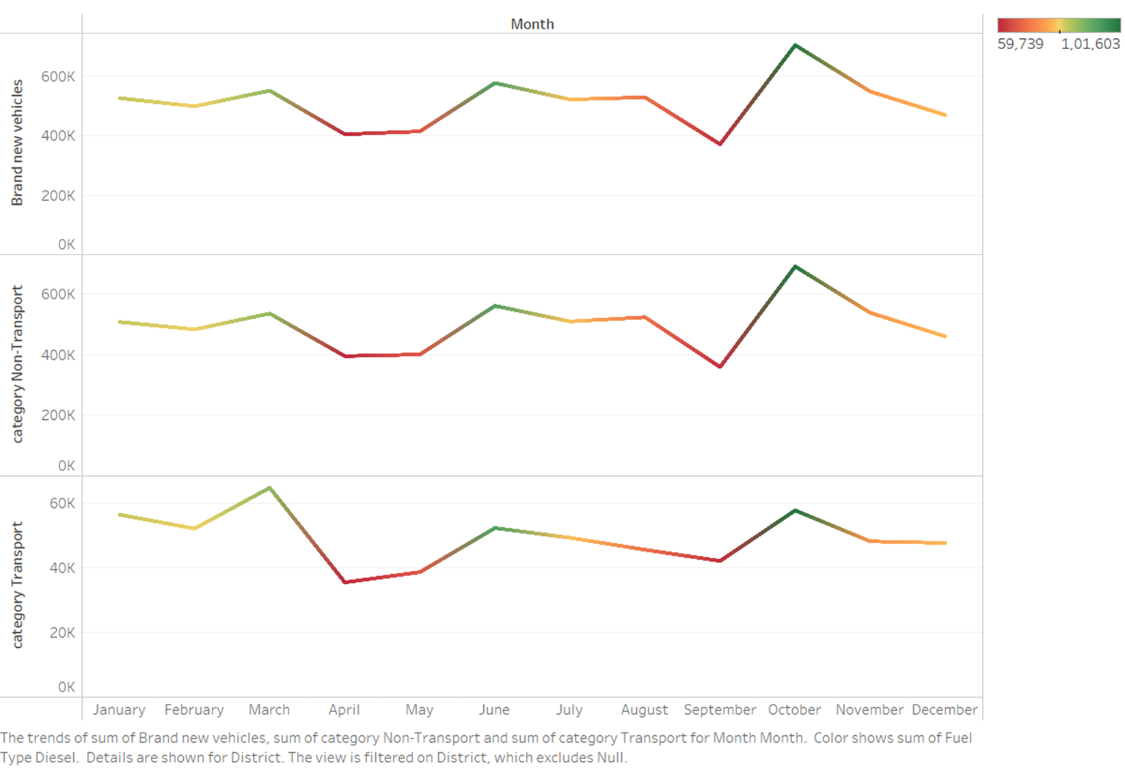
Question-5
Investigate whether there is any correlation between vehicle sales and specific months or seasons in different districts. Are there any months or seasons that consistently show higher or lower sales rate, and if yes, what could be the driving factors? (Consider Fuel-Type category only)
Across districts, positive correlations exist in vehicle sales. Quarter 2 tends to have lower sales, while quarter 4 sees higher sales due to factors like festive season promotions, end-of-year model clearances, weather conditions, and credit availability

Slide 10

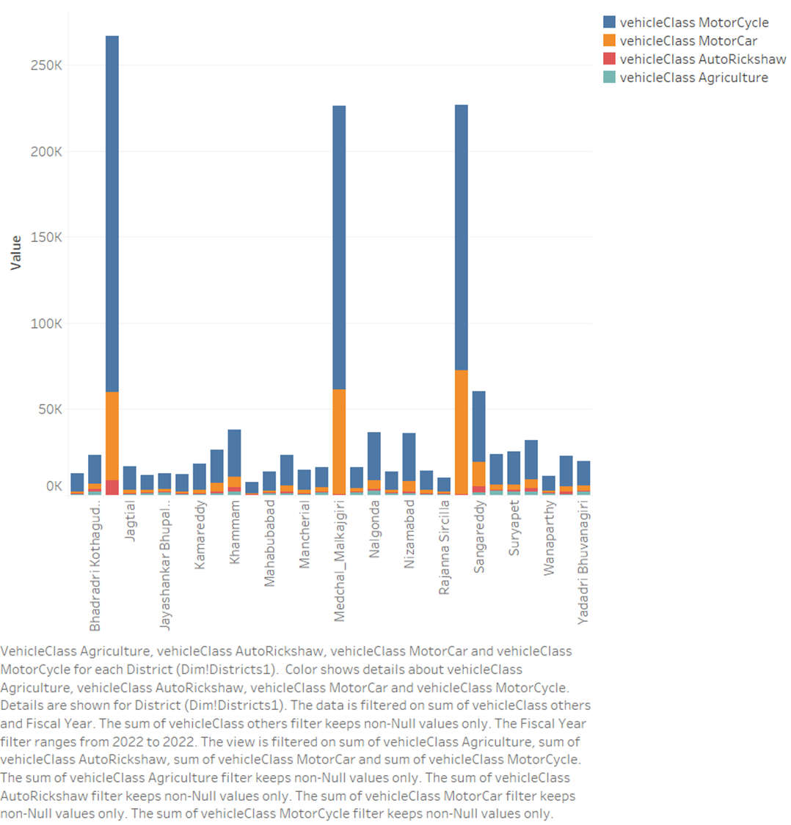
Question-6
How does the distribution of vehicles vary by vehicle class (MotorCycle, MotorCar, AutoRickshaw, Agriculture) across different districts? Are there any districts with a predominant preference for a specific vehicle class? Consider FY 2022 for analysis
Hyderabad seems to be predominant in the highest number of vehicles registered in all four vehicle classes and majority of Auto-rickshaw sales held at Hyderabad district due to the heavy population and urbanization. Many IT professionals use MotorCycle & MotorCars for there daily use.

Slide 11
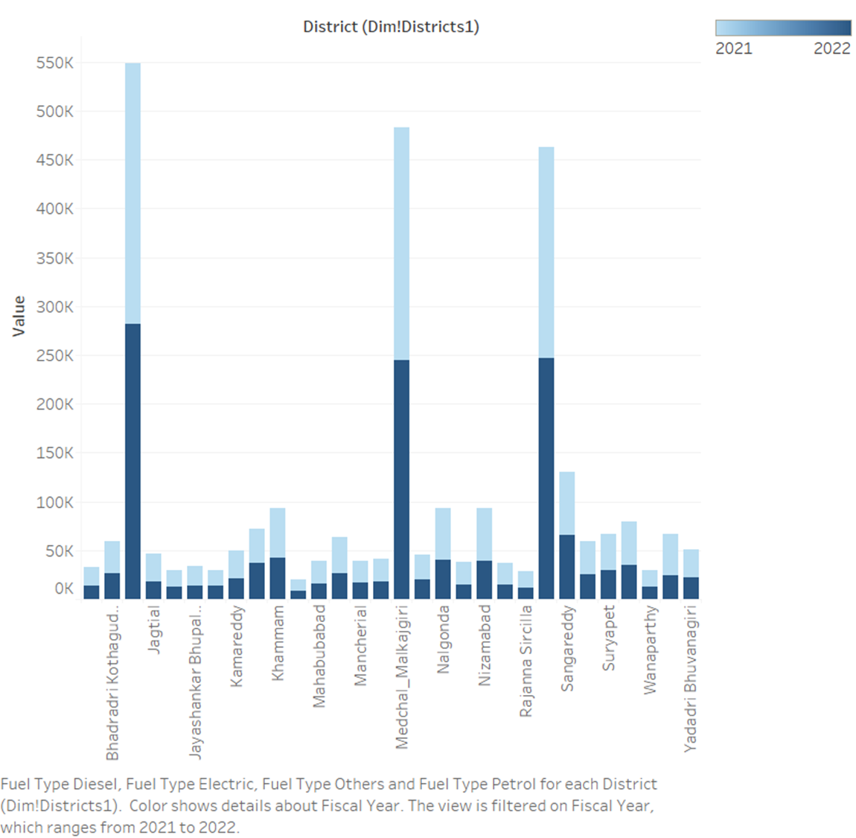
Question-7
List down the top 3 and bottom 3 districts that have shown the highest and lowest vehicle sales growth during FY 2022 compared to FY 2021? (Consider and compare categories: Petrol, Diesel and Electric)

Slide 12
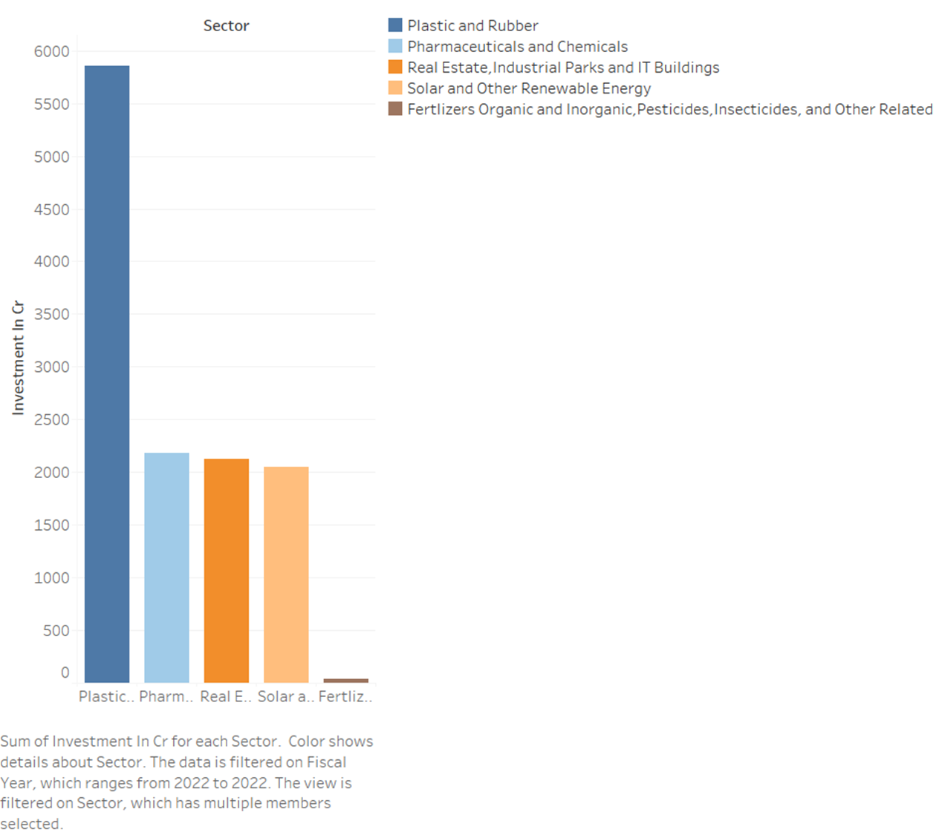

Question-8
List down the top 5 sectors that have witnessed the most significant investments in FY 2022.
Telangana Government focusing and investing large amount in Real estate, Industrial and IT buildings to make economically grow, Infrastructure development, Public private partnerships, to attract tourism etc.
And government is investing good amount in manufacturing sectors may recycling and sustainability as in focus.
As we know Hyderabad is a largest drug exporter of India. And many pharma companies exist here. Telangana's investments in pharmaceuticals often include funding for research and development (R&D) initiatives.

Slide 13
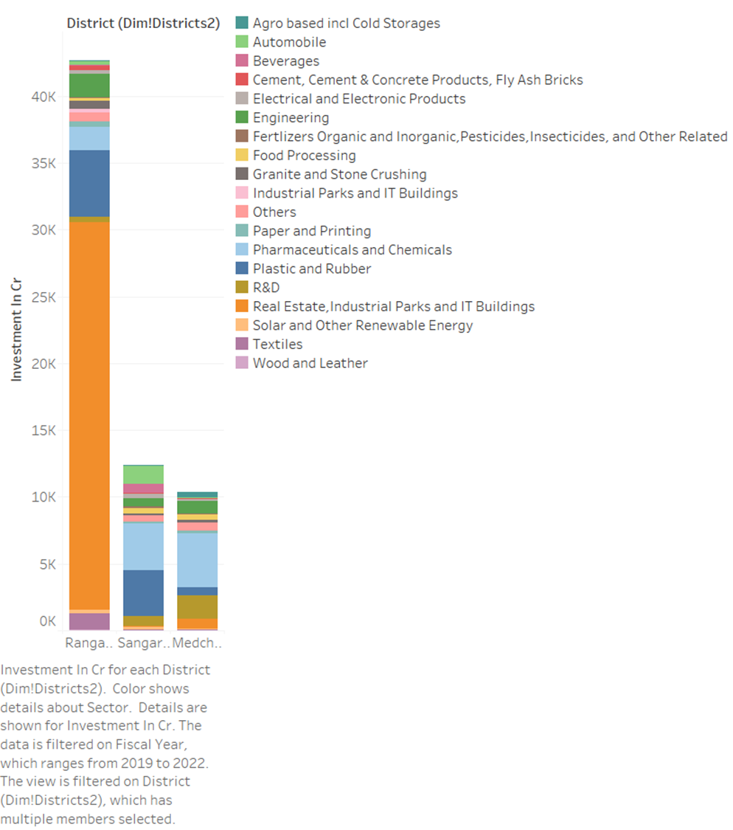
Question-9
List down the top 3 districts that have attracted the most significant sector investments during FY 2019 to 2022?
What factors could have led to the substantial investments in these particular districts?
Rangareddy, Maedchal_Malkajgiri, Sangareddy are the top 3 districts that have attracted the most significant sectoral investments from FY 2019 - 2022.
This three districts are having favorable business environment, so government is showing interest to investment in sectors at this districts.

Slide 14
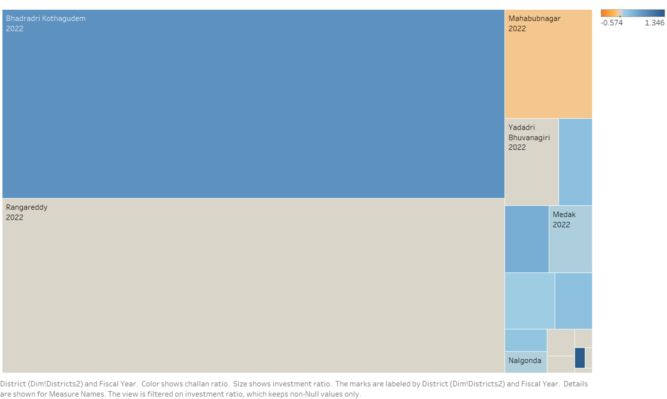

Question-10
Is there any relationship between district investments, vehicles sales and stamps revenue within the same district between FY 2021 and 2022?
Yes, there is potential co-relation between districts investment, estamps revenue & vehicle sales.
Increment of investment means good growth in economy, good infrastructure, good charging facilities for EV vehicles and many more.
Good economy growth results to good growth of vehicle sales in the market.
And good growth of vehicle sales results document revenue growth and stamp revenue growth.
Good stamp and documentation revenue will lead to investment in district sectoral investments like infrastructure, real-estate, tourism etc and many more.

Slide 15
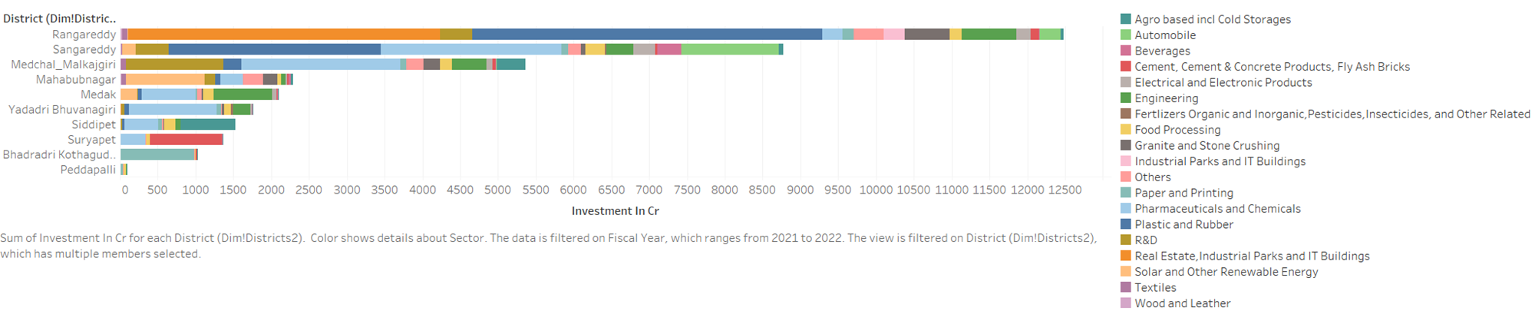
Question-11
Are there any particular sectors that have shown substantial investment in multiple districts between FY 2021 and 2022?
Yes, there are few sectors shown substantial growth in multiple districts between FY 21 & 22.
The COVID-19 pandemic drove substantial investments into Pharmaceuticals & Chemicals, primarily for medical supplies. The Plastic & Rubber sector also received significant funding, particularly for mask and glove production. Additionally, the government allocated substantial investments in sectors such as Engineering, Real Estate, and Food Processing.

Slide 16
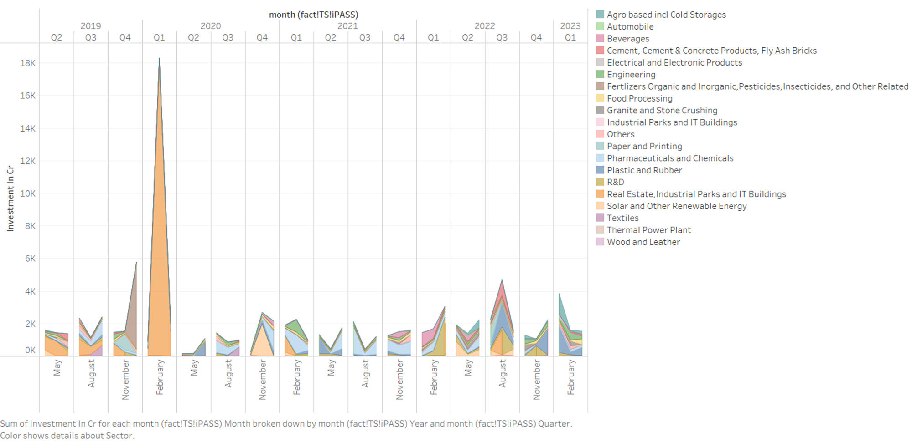
Question-12
Can we identify any seasonal patterns or cyclicality in the investment trends for specific sectors? Do certain sectors experience higher investments during particular months?
Yes, there is certain seasonal pattern and cyclic in the investment trends for specific sectors.
Real Estate: Increased investment often results from tax benefits, fiscal year-end allocations, positive economic news, investor confidence, interest rate changes, and optimistic year-start outlooks.
Pharmaceuticals: Investment surges due to factors like new product launches, regulatory approvals, and global health events such as COVID

Slide 17

What are the top 5 districts to buy commercial properties in Telangana?
Justify your answer.
Ranga Reddy: Offers a semi-urban lifestyle with significant residential and commercial development, driven by its proximity to the Rajiv Gandhi International Airport.
Medchal: Experiencing rapid urbanization and known for affordability, it's attractive for budget-friendly investments, thanks to upcoming infrastructure projects.
Warangal and Khammam: Warangal provides property investment potential with its rich cultural heritage and affordable housing options, while Khammam appeals to those seeking a peaceful environment, both offering alternatives to Hyderabad's real estate market.

Slide 18

What significant policies or initiatives were put into effect to enhance economic growth, investments, and employment in Telangana by the current government? Can we quantify the impact of these policies using available data?
TS-iPASS: Streamlined the approval process, attracting over 1 lakh crore in investments, reducing bureaucratic hurdles for industrial projects across Telangana districts.
T-Hub: As India's largest technology incubator, it cultivates innovation and supports startups, fostering a dynamic entrepreneurial ecosystem, especially in Hyderabad.
TS-BPASS: With a significant 40% increase in approvals from the previous year, this system expedites construction permissions, promoting rapid infrastructure development.
T-Fiber and Mission Bhagirath: T-Fiber expands digital access to homes and businesses, while Mission Bhagirath ensures clean water for households, indirectly enhancing economic growth through improved health and sanitation.

Slide 19
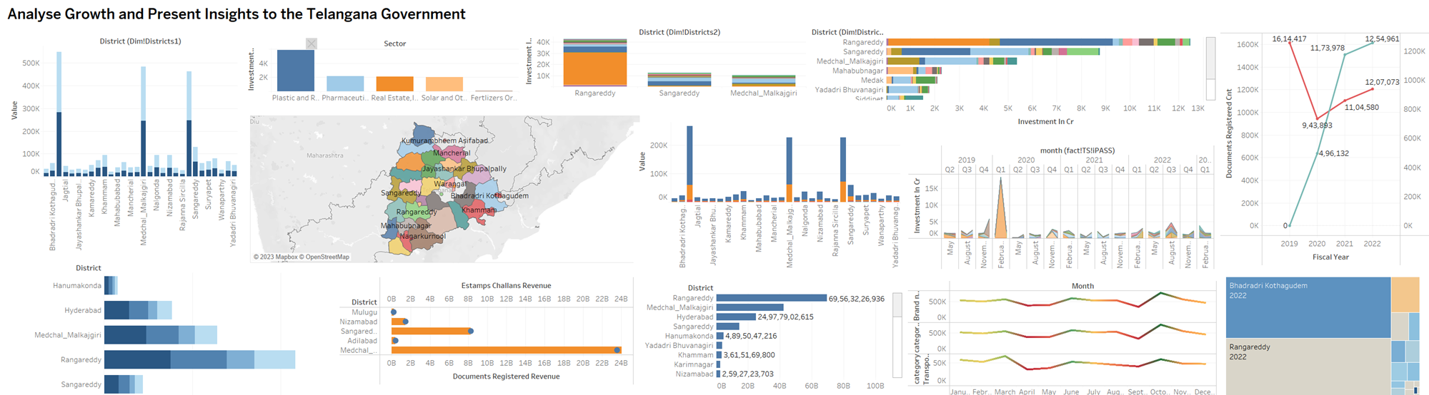

Slide 20
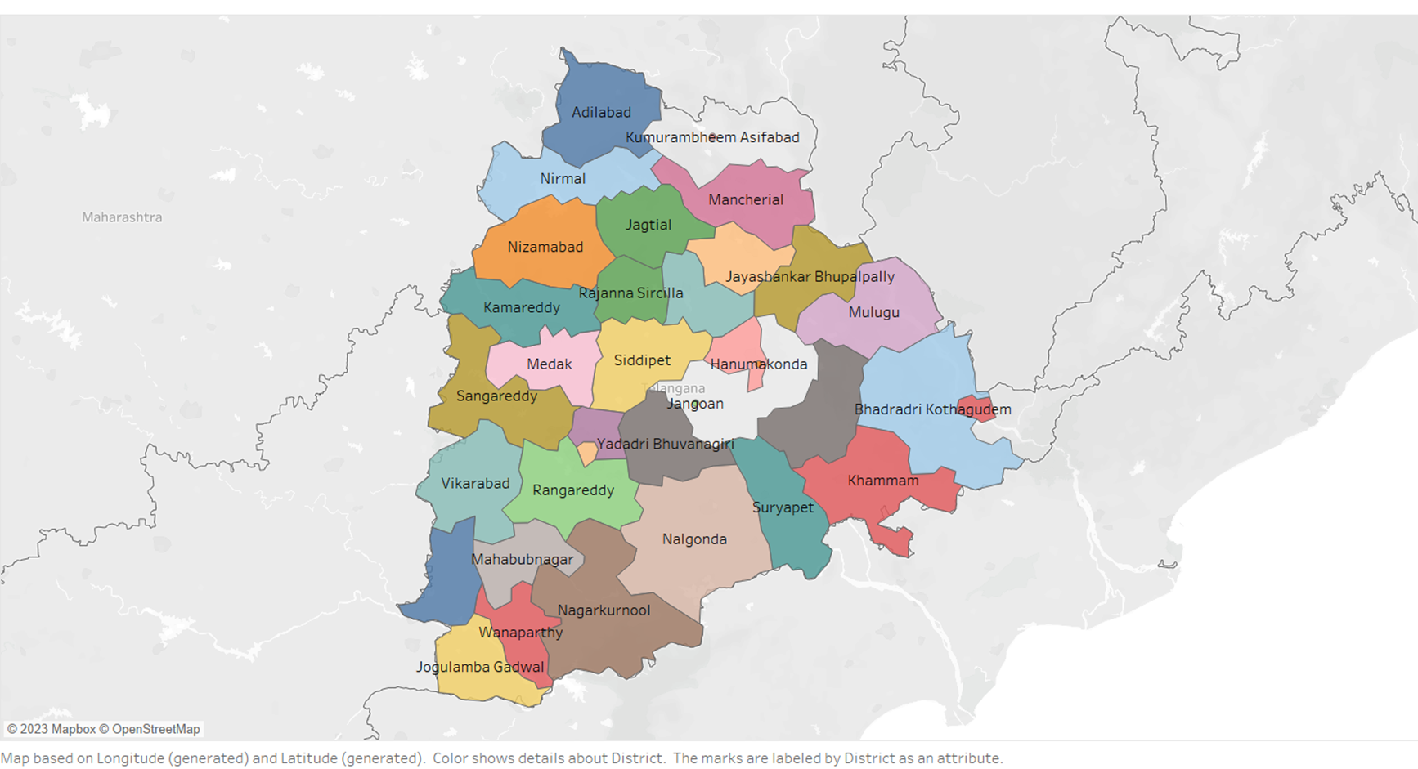
Thank You, Code basics
For Providing an Opportunity to Draw Insights from Telangana Datasets and Identify Decisions

